Slide 1
Personas
"If you really look closely, most overnight successes took a long time."
-- Steve Jobs

Slide 2
What they do
Explore ranges of behaviour
  Target market is described by the demographics.
  Personas describe the behaviour through example use.
  Similar persona behaviours describe the ranges in which the product must operate.
    It is not 1 behaviour but several which contribute to the products reciprocal behaviour.

Slide 3
Motivations
Personas are defined by the motivations of the individuals.
  The motivations describe the behaviour.
  Describe the intended use.
  Describe the perceived use.

Slide 4
Goals
Personas convert the behaviour into Goals.
  These must be made visible by the interface.
  Must be symbiotic with the user’s goals.
  Usage behaviour is thus the important motivation of a well defined persona.
  Goals may be constructed by the researched behaviours.
    Seldom defined vocally by the user
    But inferred by the designer.

Slide 5
Research is Key
As much data as possible should be collected about the users.
  Interviews.
  Field research.
  Qualitative data.
    Market research
    Domain research
    Subject matter experts.
    Focus on behaviours and motivations, not demographics.
  Avoid
    Stereo types

Slide 6
Experience Goals
Simple, universal and personal goals
  How does the product make the user feel
    Feel smart
    Feel in control
    Have fun
    Feel cool, hip or relaxed
    Focused or alert.
  Provided by initial product impressions.

Slide 7
End Goals
Represent the users motivations for performing a task.
Should be the most significant factor in determining overall product experience.
  E.g. Find what they are looking for
  Achieve a process or task, buy a book
  Clear objectives listed in itinerary.

Slide 8
Life Goals
Personal aspirations which transcend the context of the product.
Support and explain the motivations toward the end goals.
Long term desires
  Succeed in life
  Life aspirations
Will the product be a factor in achieving these goals.

Slide 9
Personas
Persona Development
Develop fictitious personalities which represent real users.
  Based on behaviour.
  Goals, skills, attitudes.
Gives focus to the design
  We design for the persona(s)
    Feature inclusion is based on needs of users, not perceived needs of designers.
  Ensures we provide for the users
    But not what we as designers or developers think should be included.
    Eliminates a design which is feature based.
Give the persona (demographic details)
  a real name.
  a real background
  age
  sex
  education
  experience etc.

Slide 10
Personas.
Goals of the persona (No more the 4)
  Life Goals (personal goals)
    Home by 5:00 (maybe useful)
  Experience Goals
    Not feeling stupid
    Having fun.
  End goals
    What they want to accomplish
Context of use
  Goals should be context specific, not general
Ideal Process
Ideal Outcome
What they might put up with. (if it is not ideal).

Slide 11
Example, Turnitin
(User)
  Sally S. (Can include a picture)
  Student, 1st year University
  Major Philosophy
  Uses a computer for:
    MSN messenger
    Games
    Surfing
(Context of use)
  Writing Essays for courses
  Must submit Essays to Turnitin as part of course
(Ideal Process)
  Select essay and press the submit button
(Ideal Outcome)
  Essay is submitted
  Confirmation that it got submitted
(Criteria & constraints) - Close to Ideal Outcome
  Use of laptop.
  Willing to read a tutorial manual.
  Willing to experiment with the system.
  Time to learn.

Slide 12
Example, Turnitin
(User)
  Steven Smith. (Can include a picture)
  Professor of Sociology
  Teaching 1st and 2nd year students.
  57 years old.
  Likes using a chalk board
  New to computers.
(Context of use)
  Faculty regulations require plagiarism monitoring.
  Check Turnitin’s reports for possible plagiarism.
(Ideal Process)
  Log in, click on course and have report generated
  Investigate suspected cases.
(Ideal Outcome)
  Report gives possible candidates for suspected plagiarism.
  Assured that report is accurate and give a level of certainty.
(Criteria & constraints) - Close to Ideal Outcome
  Little administrative overhead.
  Minimal training.
  Must work, else will not be used.
  Time to learn minimal

Slide 13
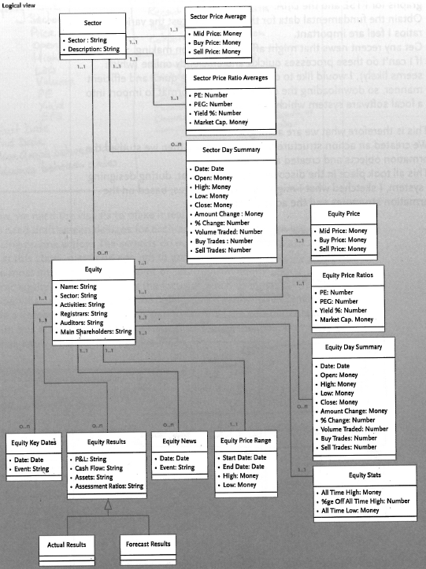
Object Relationship for financial Application
Objects define an interface to the outside world which must be addressed.

Slide 14
Non User Goals
Defined by system
  Technical specifications
  Technical Limitations
Defined by business model
  What the business wishes to achieve
Must be addressed but not at the expense of the user.

Slide 15
7 Steps Example https://uxpressia.com/blog/how-to-create-persona-guide-examples
Research
Segment your Audience
Set Demographic Info
Describe Persona Background
Define Persona Goals
Motivations & Pain Points
Add Other Ingrediants

Slide 16
Research
Interviews
BrainStorming
Gather User Data from all Sources
  Web Analytics
  Interviews
  Surveys
  Observation

Slide 17
Segment Your Audience
Aim for breadth of Audience
Attain a cross section of the user population
Duplicate traits are OK.

Slide 18

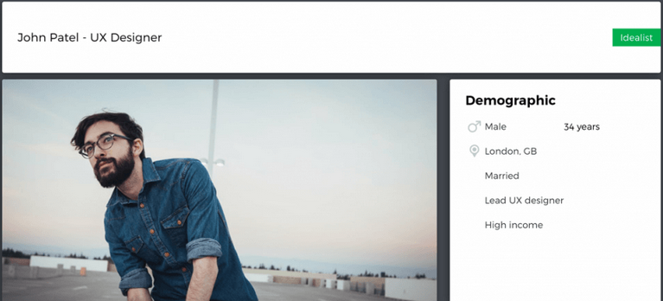
Set Demographic Info

Slide 19
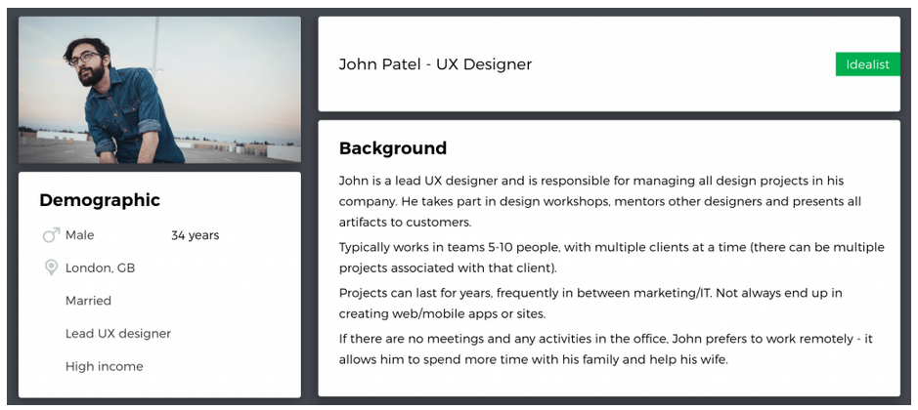
Describe Persona Background

Slide 20
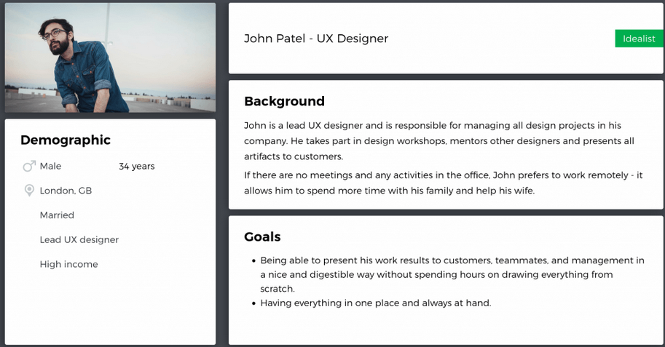
Define Persona Goals

Slide 21
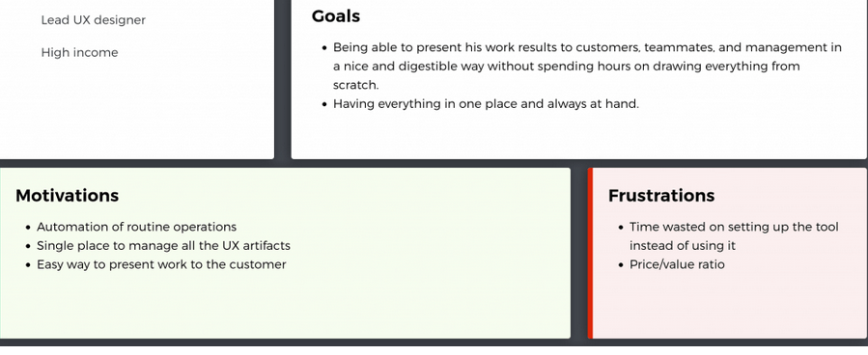
Motivations & Pain points

Slide 22
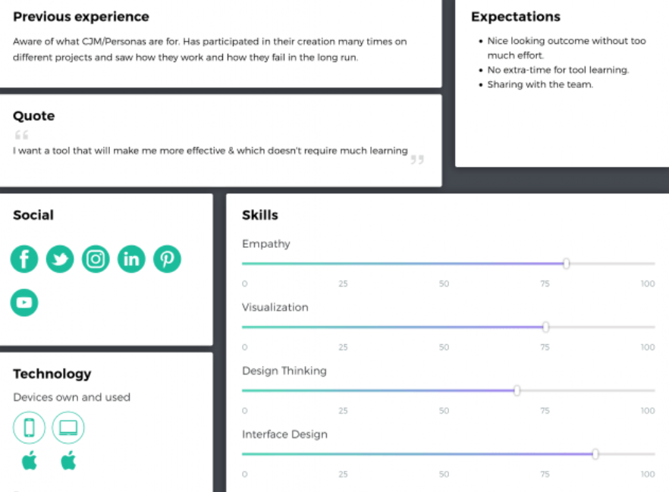
Add other Ingredients

